Slide 1
A DDS Clock Measurement Module
W.J. Riley
2016 Precise Time and Time Interval (PTTI) Meeting
Monterey, CA USA
January 27, 2016
12/28/15
Notes:
This paper describes a new technique for making high-resolution phase and frequency measurements by using a direct digital synthesizer (DDS) in a phase tracking loop.

Slide 2
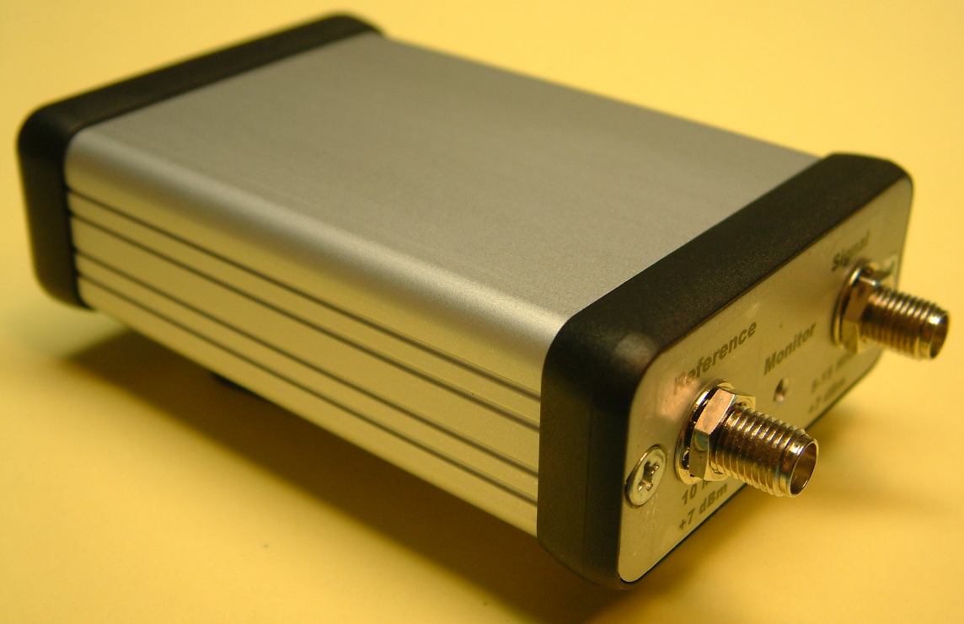
Introduction
The DDS clock measurement module is a new way to make precision phase and frequency measurements
It utilizes the high-resolution phase control capability of a direct digital synthesizer (DDS) device to implement a phase tracking loop that follows the phase variations of the signal under test.
The technique as described here has a phase resolution of 6.1 ps at 10 MHz and 11 digits/second as a frequency counter.
Notes:
The photograph shows a prototype of the DDS clock measurement module, which is about the size of a pack of cards. It has 5 MHz to 15 MHz signal and 10 MHz reference RF inputs, and a rear USB interface for data, control and power.

Slide 3
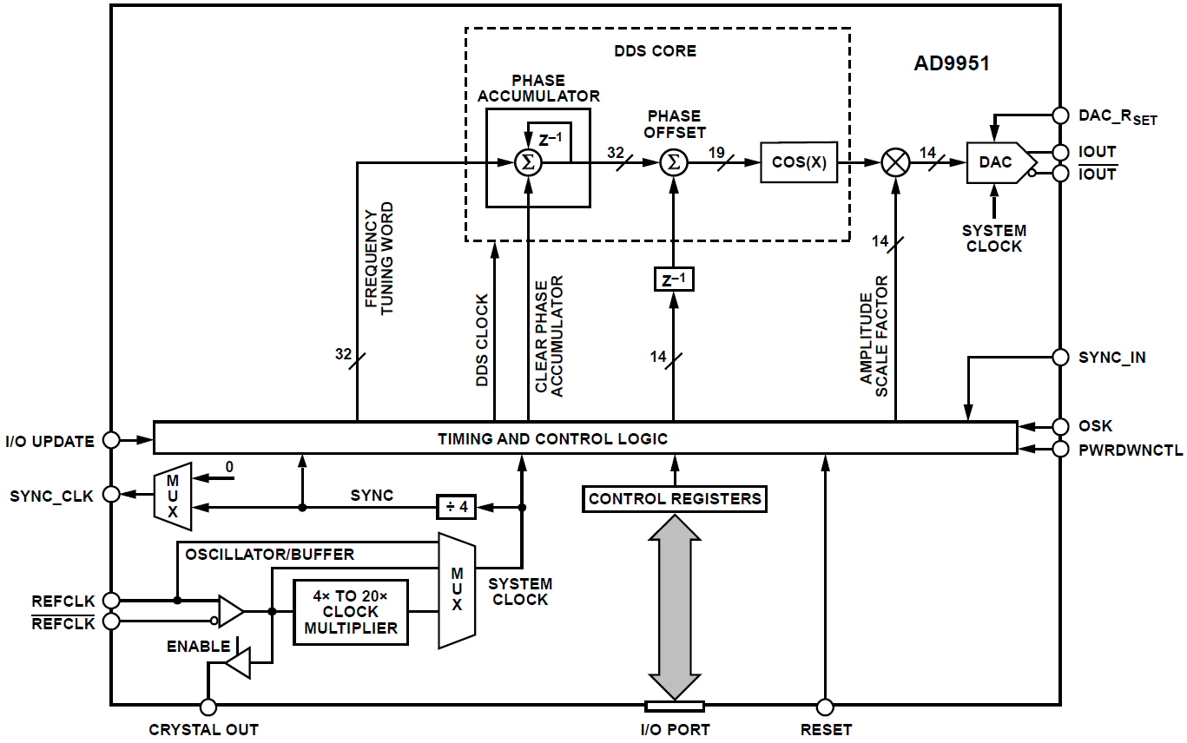
DDS Block Diagram
Notes:
This figure is a block diagram of a typical DDS chip (in this case an Analog Devices AD9951). The frequency tuning word is added to the phase accumulator each clock cycle to generate a numerical phase value that drives a cosine lookup table whose value is converted to analog form by the DAC to produce the RF output. The important feature here is that a phase offset control is provided that can be utilized to make high-resolution phase measurements.

Slide 4
Basic DDS Operation
A DDS works by incrementing its phase accumulator by the frequency word at each clock cycle.
The resulting phase value is transformed to a cosine function which is then converted into analog RF form by a DAC.
For our purposes here, the critical thing is that a 14-bit offset can be added to the phase value, thereby adjusting the phase of the RF output.
At 10 MHz, this corresponds to a phase resolution of 100 ns/2¹⁴ = 6.10 ps.
Notes:
The 14-bit DDS phase offset value divides the period of the DDS output frequency into 2¹⁴ (16,384) increments, which is only 6.1 ps at 10 MHz, and thereby provides excellent phase resolution.

Slide 5
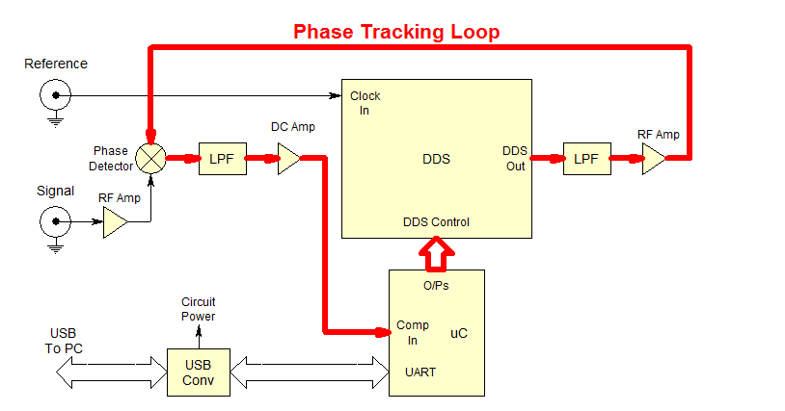
Conceptual Block Diagram
Only 2 major devices, DDS and μC
Notes:
The DDS clock measurement module uses the high-resolution DDS phase control within a phase tracking loop to make precise clock phase measurements. The loop establishes a quadrature condition between the signal and DDS reference inputs to the phase detector, which then, via the microcontroller, tracks their relative phase with the DDS phase control word providing a data stream to the PC.

Slide 6
DDS Clock Measurements
The phase tracking loop of the DDS clock measurement system keeps the phase detector centered at quadrature.
It uses the DDS phase word to produce a phase data stream to a USB port.
The phase comparator information is also used to make DDS frequency adjustments as required to maintain phase tracking.
Notes:
The DDS clock measurement module phase data are the DDS phase offset word values. Their increments represent both phase variations and fractional frequency changes. The DDS frequency control word is used to adjust the DDS frequency as necessary to maintain phase tracking.

Slide 7
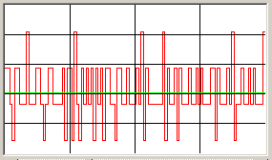
Phase and Frequency Data
Without noise or frequency offset, the phase tracking corrections would alternate between two adjacent phase values.
Those alternations eliminate any dead zone, but cause quantization at a level of twice the phase resolution.
Noise will cause additional phase excursions depending on its magnitude. That is the desired phase data.
A frequency offset will cause a bias in the phase corrections depending of its sense and magnitude. The resulting phase slope is the desired frequency data.
Notes:
The phase tracking loop is a “bang-bang” servo whose state alternates between two adjacent values in the absence of noise or frequency offset. This results in a squarewave with a peak-to-peak variation of twice the DDS LSB phase increment, an RMS variation equal to the DDS resolution. System and source noise add to that, and allow measurement of source phase fluctuations that are above the system noise floor.
In addition, frequency offset causes a phase slope which biases the phase corrections in one direction. It is necessary that the frequency offset not exceed the dynamic range of the phase corrections during a tracking cycle, so means must be provided to make DDS frequency adjustments to assure that the phase tracking loop remains operative. The DDS frequency tuning resolution is enough that the effect of its offset is manageable, but nevertheless must be removed from the reported data by the system software.

Slide 8
Frequency & Phase Acquisition
Before starting a measurement, the DDS must be set to the signal frequency, and the phase tracking loop must acquire lock.
The DDS frequency is set either to the nominal value entered by the user, or automatically using a coarse frequency count and a fine beat note period measurement.
The module then acquires phase lock aided by initially using coarse phase increments.
Phase lock is confirmed by verifying a quadrature condition at the phase detector output.
Notes:
The need for frequency and phase lock acquisition is a distinguishing feature of the DDS clock measurement concept. Fortunately, neither requirement is a serious problem. The DDS frequency should be set to the value closest to that of the applied signal, a tolerance on the order of 1x10⁻⁹. A DDS frequency error of a couple increments is acceptable but best avoided. So the frequency acquisition process uses either a user-supplied nominal frequency or makes an automatic measurement using a combination of a coarse frequency and a fine beat period measurement to set the DDS frequency to within that tolerance.
Phase lock will then occur by itself for this 1st order phase tracking loop, but is speeded up by using larger DDS phase control increments when the phase error is large.
The phase detector DC output voltage serves as a means for verifying that the loop is locked to a quadrature condition between its signal and DDS reference inputs.

Slide 9
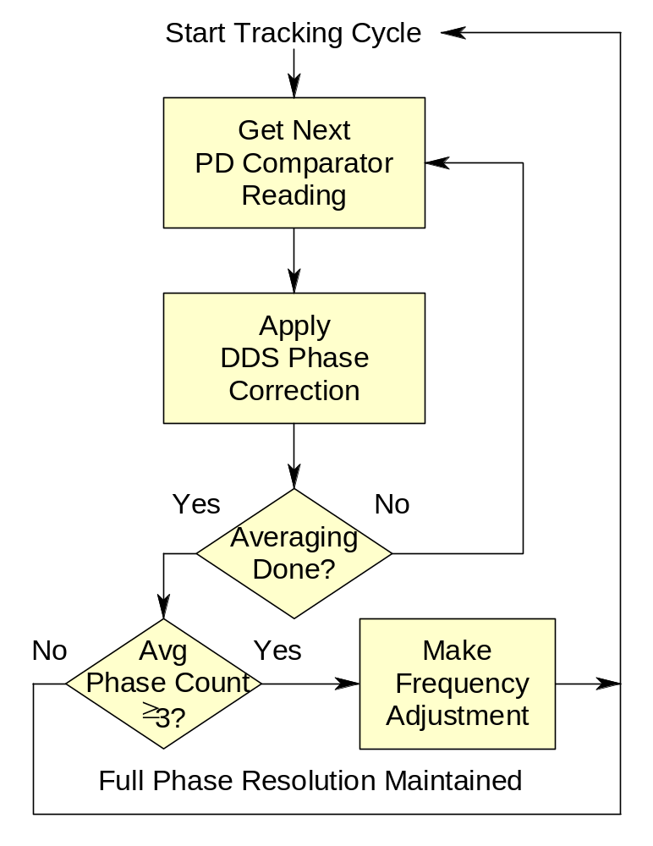
Phase & Frequency Tracking
Notes:
Phase and frequency tracking is implemented by DDS clock measurement module firmware. During each tracking cycle. The state of the phase detector comparator is read and a DDS phase correction is applied accordingly. Those phase corrections are averaged over several cycles, and, if they exceed a certain threshold, a DDS frequency adjustment is made to keep the phase tracking loop within its dynamic range. Most sources under test will not require frequency adjustments, but, on the other hand, an unstable source may have frequency excursions that exceed the frequency slew limit of the system. That limit can be extended by allowing larger DDS frequency increments, but is a fundamental limitation on the applicability of the system.

Slide 10
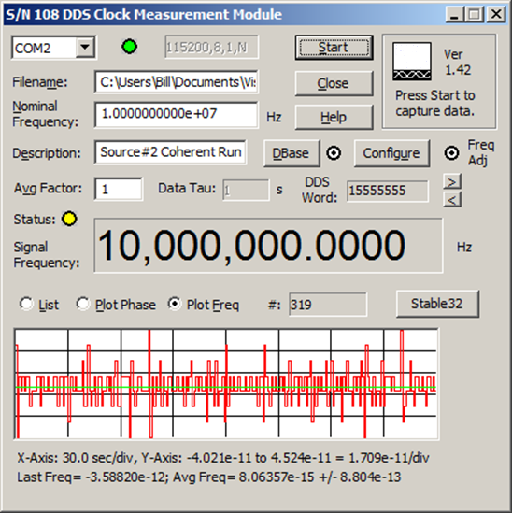
User Interface Main Screen
Notes:
The DDS clock measurement module requires a user interface to work with its hardware and firmware to configure and control the module, and process, display, timetag and save the resulting phase data. The Windows® graphic user interface shown provides those functions.
The program must first connect the module to the host PC via a virtual COM port, and optionally to its PostgreSQL database. The user then enters the desired measurement parameters: the data filename, the nominal source frequency, a description of the measurement run, and the desired averaging factor for the stored data. Other configuration items (such as activating the database and frequency adjustments) are set in the DBase and Configure screens with their respective buttons.
The module acquires frequency and phase lock, displays the hex DDS word, and activates the Start button. Pressing Start begins the measurements, which are displayed as a list of numeric values, or a plot of the phase or fractional frequency. Progress is also indicated by the # of data points. At any time, Stable32 or another frequency stability analysis program such as TimeLab can be launched. The measurement run continues until the Stop button is pressed.

Slide 11
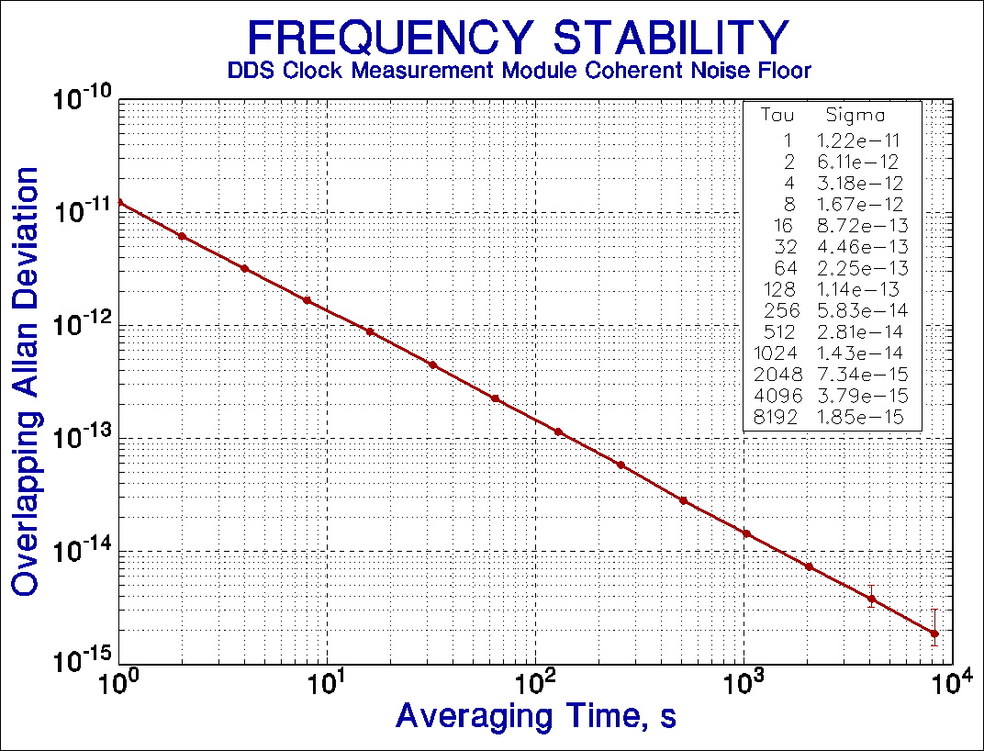
Noise Floor
Notes:
The DDS clock measurement module white PM noise floor is determined by a combination of quantization noise and additional system noise contributed by the DDS, phase detector and other circuits. It has a typical level of 1.3x10⁻¹¹ at 1 second and decreases as the averaging time (tau) down into the pp10¹⁶ range. This level of performance is adequate for measuring most precision frequency sources, especially at longer averaging times.

Slide 12
Condensed Specifications
Parameter | Specification
Frequency Range | 5 to 15 MHz
Phase Resolution | 6.1 ps at 10 MHz
Frequency Resolution | 1x10⁻¹¹/second
Noise | ≤1.5x10⁻¹¹/τ
Frequency Accuracy | <1x10⁻¹⁵
Temperature Sensitivity | 5 ps/°C
Frequency Slew Tolerance | ≤3x10⁻⁸/second
Signal and Reference Inputs | Sinewave +7 dBm 50 Ω
Interface | USB data, control & power
Data Streams | 5 formats, 10 ms & 1s
Power | <0.5 W
Size (LxWxH) | 3.28”x2.25”x1.03”
Weight | <5 oz
Notes:
These are preliminary specifications based on several prototype units. The frequency range could be extended by straightforward design changes. Several means are feasible to improve the phase and frequency resolution and noise. The frequency accuracy is applicable only for long measurement runs, is limited only by software numerical precision, and has been measured to be an order-of-magnitude better than shown. The temperature sensitivity is reasonable. The frequency slew limit isn’t a problem for sources requiring high resolution measurements.

Slide 13
Advantages & Disadvantages
Advantage
Disadvantage
Moderately high resolution
Small, simple, low power, low cost hardware
Operation at any nominal frequency within range
High (100 Hz) sampling rate available
Able to track relatively high frequency slew rate
Not extremely high resolution
Unfamiliar measurement principle
Somewhat limited frequency range
Resolution loss at shorter sampling times
Limited frequency slew tracking rate
And, of course, it makes actual phase measurements
Notes:
The DDS clock measurement module offers moderately high resolution, but it is inadequate for some high stability frequency sources at shorter sampling times. Ways exist for improving the resolution somewhat. It makes phase measurements which is always an advantage, even if the objective is fractional frequency data (which is also directly available).
The hardware is small, simple, low power and low cost, but uses an unfamiliar measurement principle. It is not limited to a particular nominal frequency, but does have a limited frequency range. Extending the operating range toward lower frequencies is easy, but comes at the expense of lower resolution unless the DDS operates at a multiple of the input signal frequency. Extending the operating range toward higher frequencies is also feasible, within the range of DDS technology or via prescaling. A relatively fast sampling rate is available, but at the expense of lower factional frequency resolution. The DDS clock measurement principle uses a phase tracking loop that has an inherent tracking limit for frequency slew. But this is high enough for most precision clock measurements.

Slide 14
Applications
Phase and frequency measurements:
  For just about any precise or semi-precise source
  at any frequency between 5-15 MHz
Particularly well-suited for:
  Measurements against a GPS timing receiver
  Portable measurements with a laptop computer
  A substitute for a high-resolution counter
  Avoiding tying up an expensive system
  Embedding into an instrument
Notes:
The DDS clock measurement module has a wide range of applications for precision and semi-precision phase and frequency measurements between 5-15 MHz. It has proven to be a handy substitute for more expensive measurement systems, especially when set up for long runs at fairly long sampling times, and used with a laptop computer that provides immunity from short and medium term power outages.

Slide 15
Conclusion
The DDS clock measurement concept has been proven viable, and is an effective technique for making precise phase measurements.
Notes:
Several DDS clock measurement modules have been built and tested with consistent results, requiring no adjustments or calibration. There have been no significant problems with either acquisition or tracking. The modules seem quite immune to external interference, outliers are practically non-existent, and the user interface is easy to use. Runs of a month or more are generally glitch-free, especially if the host computer is a laptop or on an UPS. Frequency inaccuracy is at the pp10¹⁶ level based on long coherent runs. The modules seem particularly well-suited for making continuous measurements of rubidium oscillators against a GPS timing receiver at sampling times of 10 seconds and longer. Their resolution and noise floor is adequate for measuring the long term stability of even very high performance sources.

Slide 16
Backup Slides
Notes:
The following slides provide additional information about the DDS clock measurement module.

Slide 17
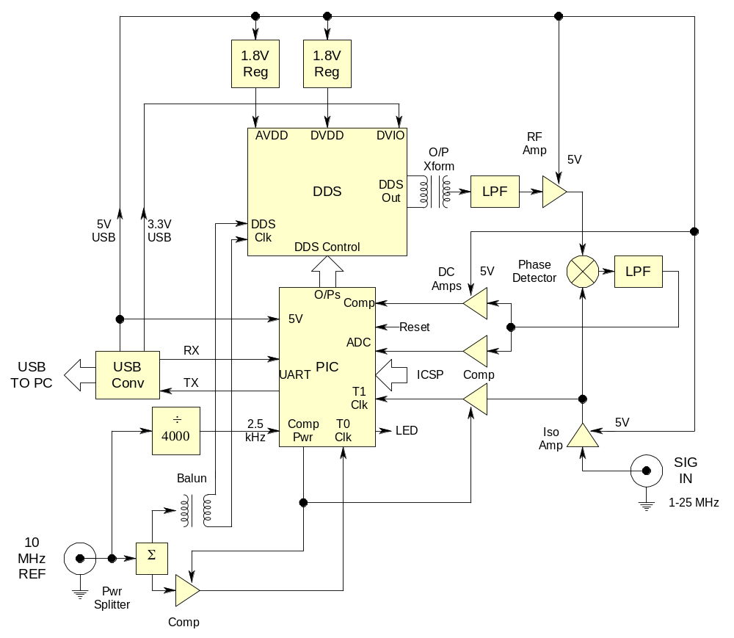
Detailed Block Diagram
Notes:
This complete block diagram of the DDS clock measurement module shows all its sections.
The DDS section contains the DDS synthesizer with its reconstruction low pass filter, the PIC microcontroller and the USB interface converter. The PIC is programmed via its in-circuit programming (ICSP) interface. A reset switch and a monitor LED are also included.
The RF section contains RF amplifiers for the signal under test and reference signals, the phase detector and its low pass filter, two DC amplifiers and the signal comparator.
The reference section accepts a 10 MHz sinewave signal at a nominal level of +7 dBm and splits it to clock the DDS differentially, drive a comparator to provide a reference squarewave to the PIC Timer0 input, and drive another PIC device that divides it by 4000 to produce a 2.5 kHz coherent sampling rate.
The power section contains two +1.8 V linear regulators for the DDS DVdd and AVdd supplies.

Slide 18
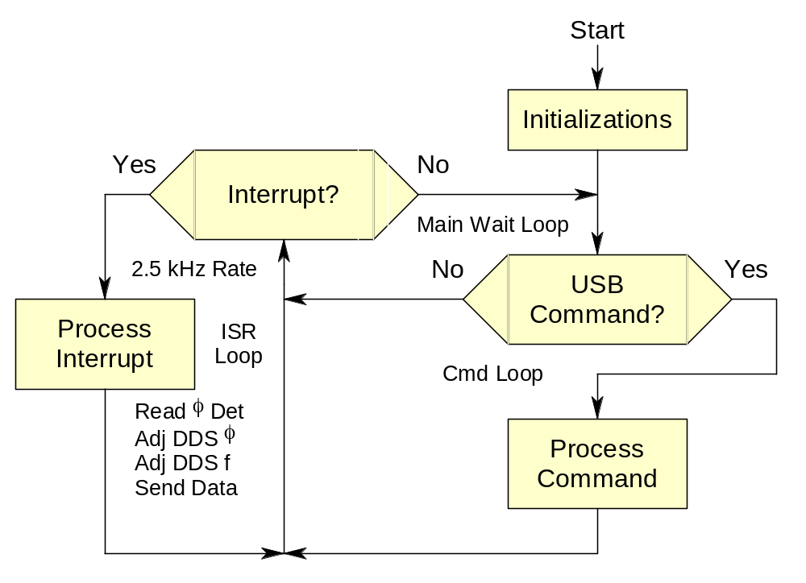
Firmware Flowchart
Notes:
The DDS clock measurement module firmware is responsible for making the clock measurements and responding to user interface commands. The program executes a main wait loop until either an external interrupt initiates a measurement function or a command is received from the USB interface.
The measurement interrupts occur at a 2.5 kHz rate driven by a hardware ÷4000 from the 10 MHz reference. The measurement process is divided into 25 sections each performing a task that can be completed within its allotted 10 ms slot. These activities read the state of the phase detector comparator, make appropriate DDS phase corrections and frequency adjustments, and send data to the host PC via the USB interface.
The USB commands configure and control module operation. They get, set and display such parameters as the DDS phase and frequency words, DDS clock multiplier factor, frequency adjustment step size and flag, and the data stream format. Other commands increment and decrement the DDS frequency, check the reference and signal inputs, read the phase detector and supply voltages, measure the signal frequency and beat period, module temperature, report the module model #, S/N, firmware revision and status, flash an LED, reset the microcontroller, and display command help.

Slide 19
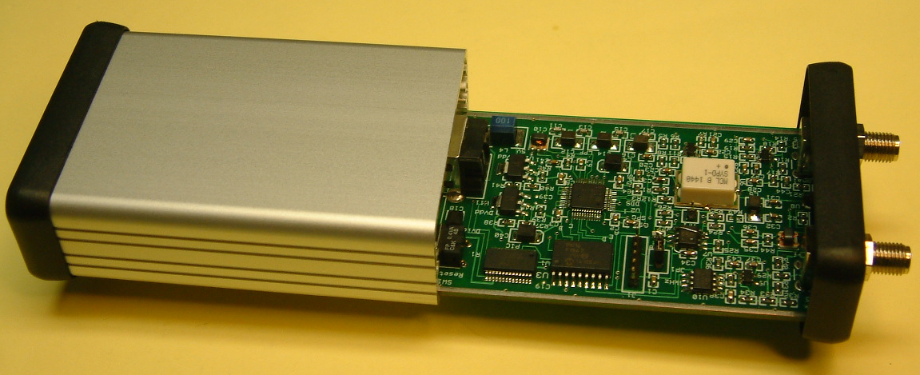
Module Packaging
Notes:
The DDS clock measurement module is implemented on a single 2-layer 50mm x 80mm circuit board as shown in Figure 7. It uses surface mount components and it requires no hand wiring, adjustments or calibration. The board then slips into its 1” high x 2” wide x 3 ½’ deep extruded aluminum case.
The three largest chips are the main PIC microcontroller, the DDS and the USB interface. The white component is the analog phase detector, and the main microprocessor firmware is loaded via a 1x6 pin 2 mm header.
The front panel contains SMA connectors for the reference and signal inputs, and a status LED indicator. The read panel has a type B USB receptacle and a reset pushbutton.

Slide 20
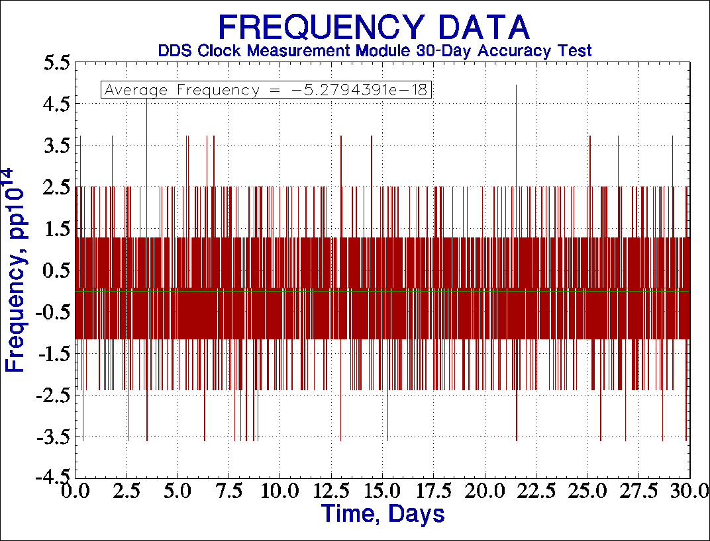
Accuracy Test
Notes:
The accuracy of the DDS clock measurement module is determined primarily by the numerical precision employed in making its DDS frequency offset correction, which is done with double-precision (16-digit) calculations. Measurement noise limits the degree to which that accuracy is actually realized, and a long measurement duration is required to determine it. This plot shows the results of a 30-day coherent accuracy test where the overall average frequency error was only about -5x10⁻¹⁸.

Slide 21
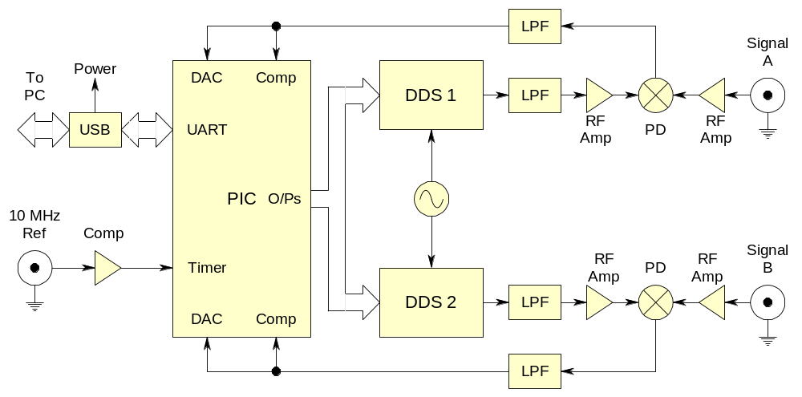
Dual Channel Module
Notes:
As shown, a free-running low-jitter VHF crystal oscillator clock the two DDS to provide lower noise than possible with their internal clock multipliers. Because the DDS clock is common to both channels, its frequency offset cancels out.
If the DDS clock is the reference, this arrangement can measure two signals. If the same source is applied to both inputs, a cross-correlation measurement can be made, which can reduce the noise floor by a factor of about x5.
The same general architecture can be used to implement a multi-channel system.

Slide 22
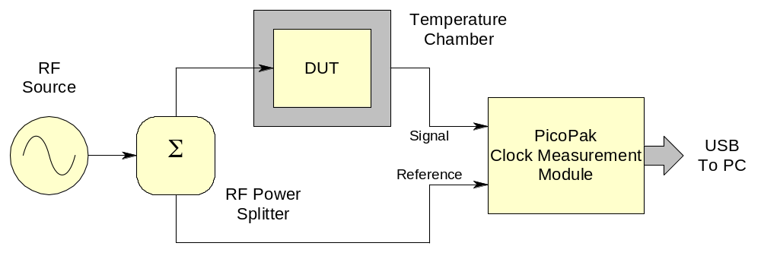
2-Port Network Measurement
Notes:
The module can also be used to measure the phase stability of a passive or active two port network with the test setup shown. This setup is similar to that of a coherent noise test except that the device under test (DUT) is inserted into the signal path. For example, the DUT may be placed in a temperature chamber to measure its phase sensitivity to temperature.

Slide 23
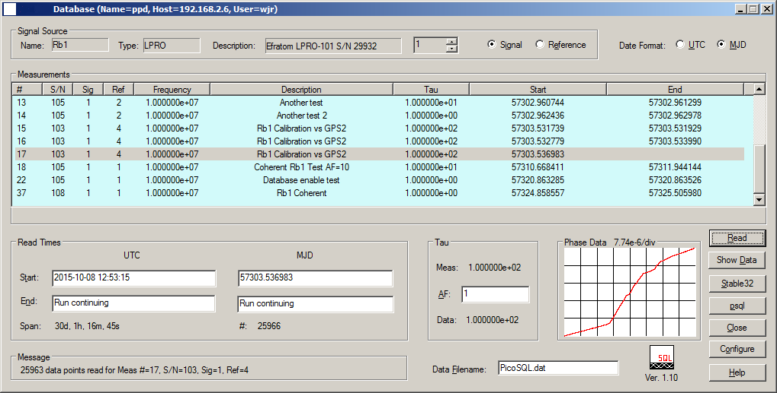
Database User Interface
Notes:
The DDS clock measurement system includes an optional PostgreSQL database to store and access clock data. This is an effective way to archive clock measurements. The database user interface retrieves clock data for the selected signal and reference sources for a certain time span, writing the data to a disk file and supporting analysis by Stable32 or another stability analysis program.

Slide 24
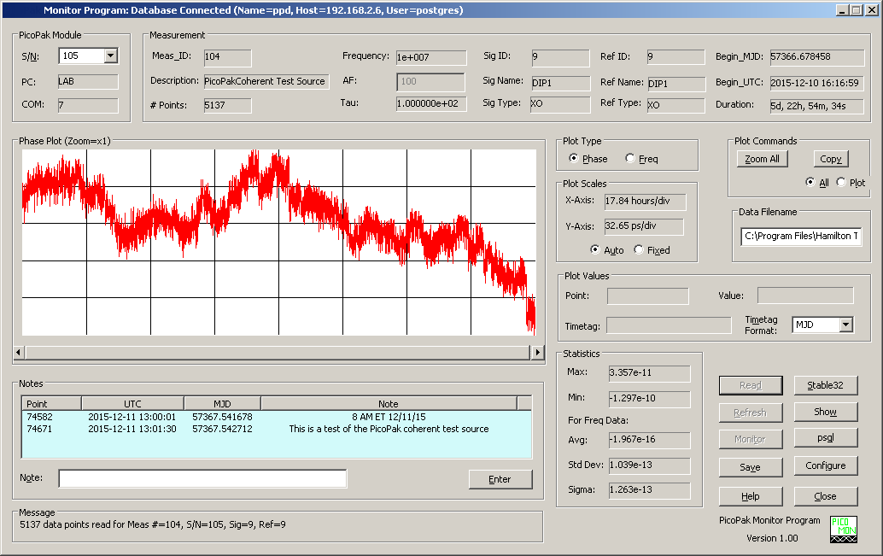
Monitoring Program
Notes:
The DDS clock measurement system also includes a monitoring program that works with the optional PostgreSQL database. The progress of an active clock measurement can be observed in real-time, and timetagged notes can be inserted into the database to mark events.

